Slide 1
Extract and Explore
REDCap + R Workshop
REDCapCon 2023

Slide 2
The REDCapR Package Demo
Notes:
(Might wan to mention here – next few min will be background and not critical to understand the rest, so if there are issues with logging into the server, please have TAs help troubleshooting now.)

Slide 3
https://htmlpreview.github.io/ ?https://github.com/skadauke/redcapcon_2023_redcap_r_workshop/blob/main/exercises/01a_redcapr.html https://github.com/skadauke/redcapcon_2023_redcap_r_workshop

Slide 4
REDCapTidieR
Notes:
(Might wan to mention here – next few min will be background and not critical to understand the rest, so if there are issues with logging into the server, please have TAs help troubleshooting now.)

Slide 5

REDCapTidieR
Makes it easy to import any REDCap project into R
Even if complex: longitudinal, repeated events or instruments, surveys, and/or data access groups (DAGs)
Pulls data and metadata into a supertibble that can be easily explored in RStudio IDE and works with pipes
Is robust and efficient
Built on top of REDCapR
Follows tidyverse software development lifecycle recommendations
97% test coverage
Extensive error checking with helpful error messages
Profiled and replaced tidyverse code with base R where we found bottlenecks
Notes:
And that's how REDCapTidieR was born, an open-source package that we first launched a year ago.
REDCapTidieR makes it easy to import any REDCap project into R, even the complex ones that contain longitudinal or repeated instruments or events. It does so by integrating data and metadata into a single object – the supertibble. It’s easy to explore the supertibble in the RStudio IDE and manipulate it using tidy semantics, like the pipe operator.
*** We ensured that it's both robust and efficient so it can be used in a production environment. It's built on the REDCapR package, follows tidyverse SDLC recommendations, and has pretty good test coverage and enabled continuous integration on GitHub. It also offers extensive error checking with helpful error messages, and we have profiled it and replaced tidyverse code with base R in areas where we found bottlenecks.

Slide 6
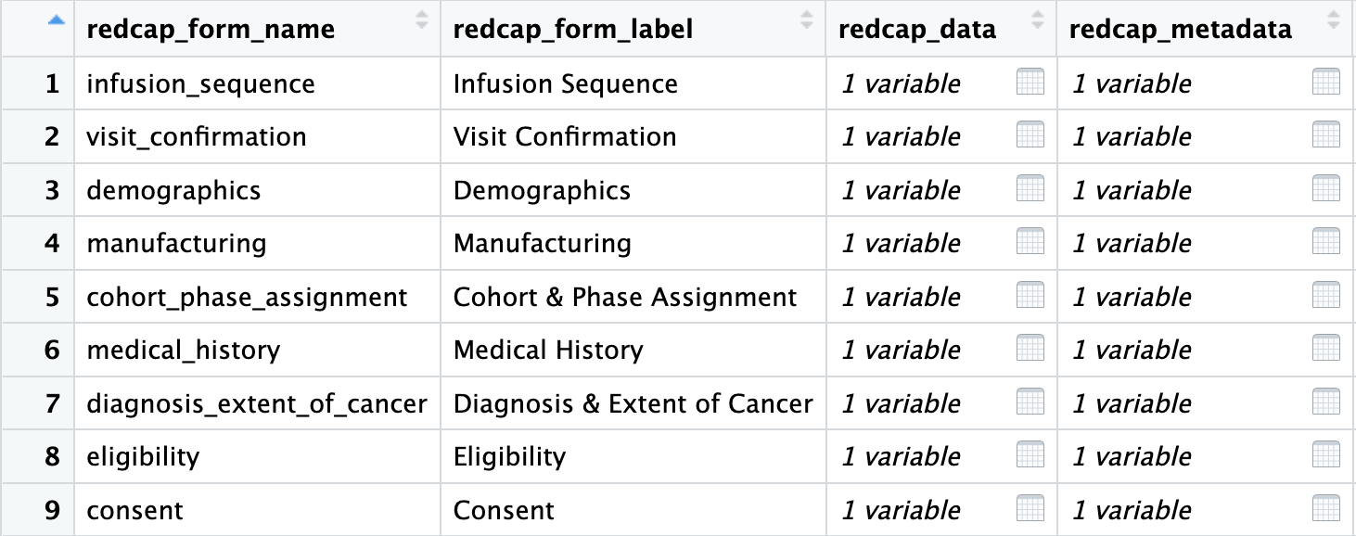
The REDCapTidieR Supertibble
Use read_redcap() to import a REDCap project into R
Returns a supertibble which contains data and metadata broken down by instrument
Notes:
Let's delve deeper into the REDCapTidieR supertibble. This object is generated when you read a REDCap project using the `read_redcap()` function.
Here, you can see part of the supertibble from the Prodigy trial displayed in the Rstudio IDE Viewer. Each row of the supertibble represents an instrument. You can see the name and label of the instrument. And then you have two list columns containing tidy tibbles with the data and the field-level metadata from the project.
By clicking on the table icon, you can drill down into individual data and metadata tibbles. This makes initial data exploration really easy.

Slide 7
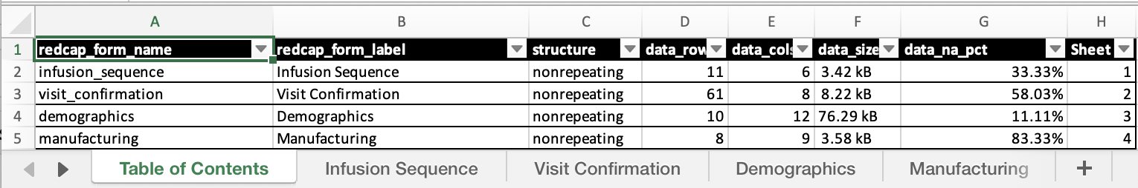
What can I do with the Supertibble?
Use bind_tibbles() or extract_tibble() to extract data from individual instruments
Plays well with %>% or |>
Use make_labelled() to add variable labels
Uses {labelled} to attach REDCap field labels to data columns
Use write_redcap_xlsx() to export to Excel
Collaborator-friendly! Supports labels
Notes:
So, what can you do with the Supertibble?
- You can extract data frames for individual instruments using either the bind_tibbles() or extract_tibble() function. Bind_tibbles() makes the data tibbles magically appear in the Environment. Extract_tibble() extracts and returns an individual data tibble. This functionality pairs well with the pipe operator.
*** You can use make_labelled() to add variable labels. This employs the {labelled} package to attach REDCap field labels to data columns, reusing the descriptions in data entry forms as variable descriptions.
*** And finally, you can use write_redcap_xlsx() to export to Excel. This feature is particularly handy for collaborating, and it supports labels so your collaborator can see the descriptions for each variable. Here’s what the Prodigy database looks like as an Excel sheet – you can see that there’s a table of contents, and each instrument’s data is in its own tab.

Slide 8
Your Turn
Open the 01_extract_explore.qmd file in the exercises folder.
Read what it says and follow the instructions to complete the exercise.

Slide 9

Recap
REDCapR is the OG and provides both API access and other functions to work with REDCap databases in R
REDCapTidieR is useful to work with complex projects that contain longitudinal structure or repeated instruments into R.
The REDCapTidieR supertibble …
Notes:
To recap what we covered up to this point, …

Slide 10
What else?
Notes:
The “What Else?” section should mention things that would be covered in a comprehensive course and/or are of strong interest to the intended audience

Slide 11
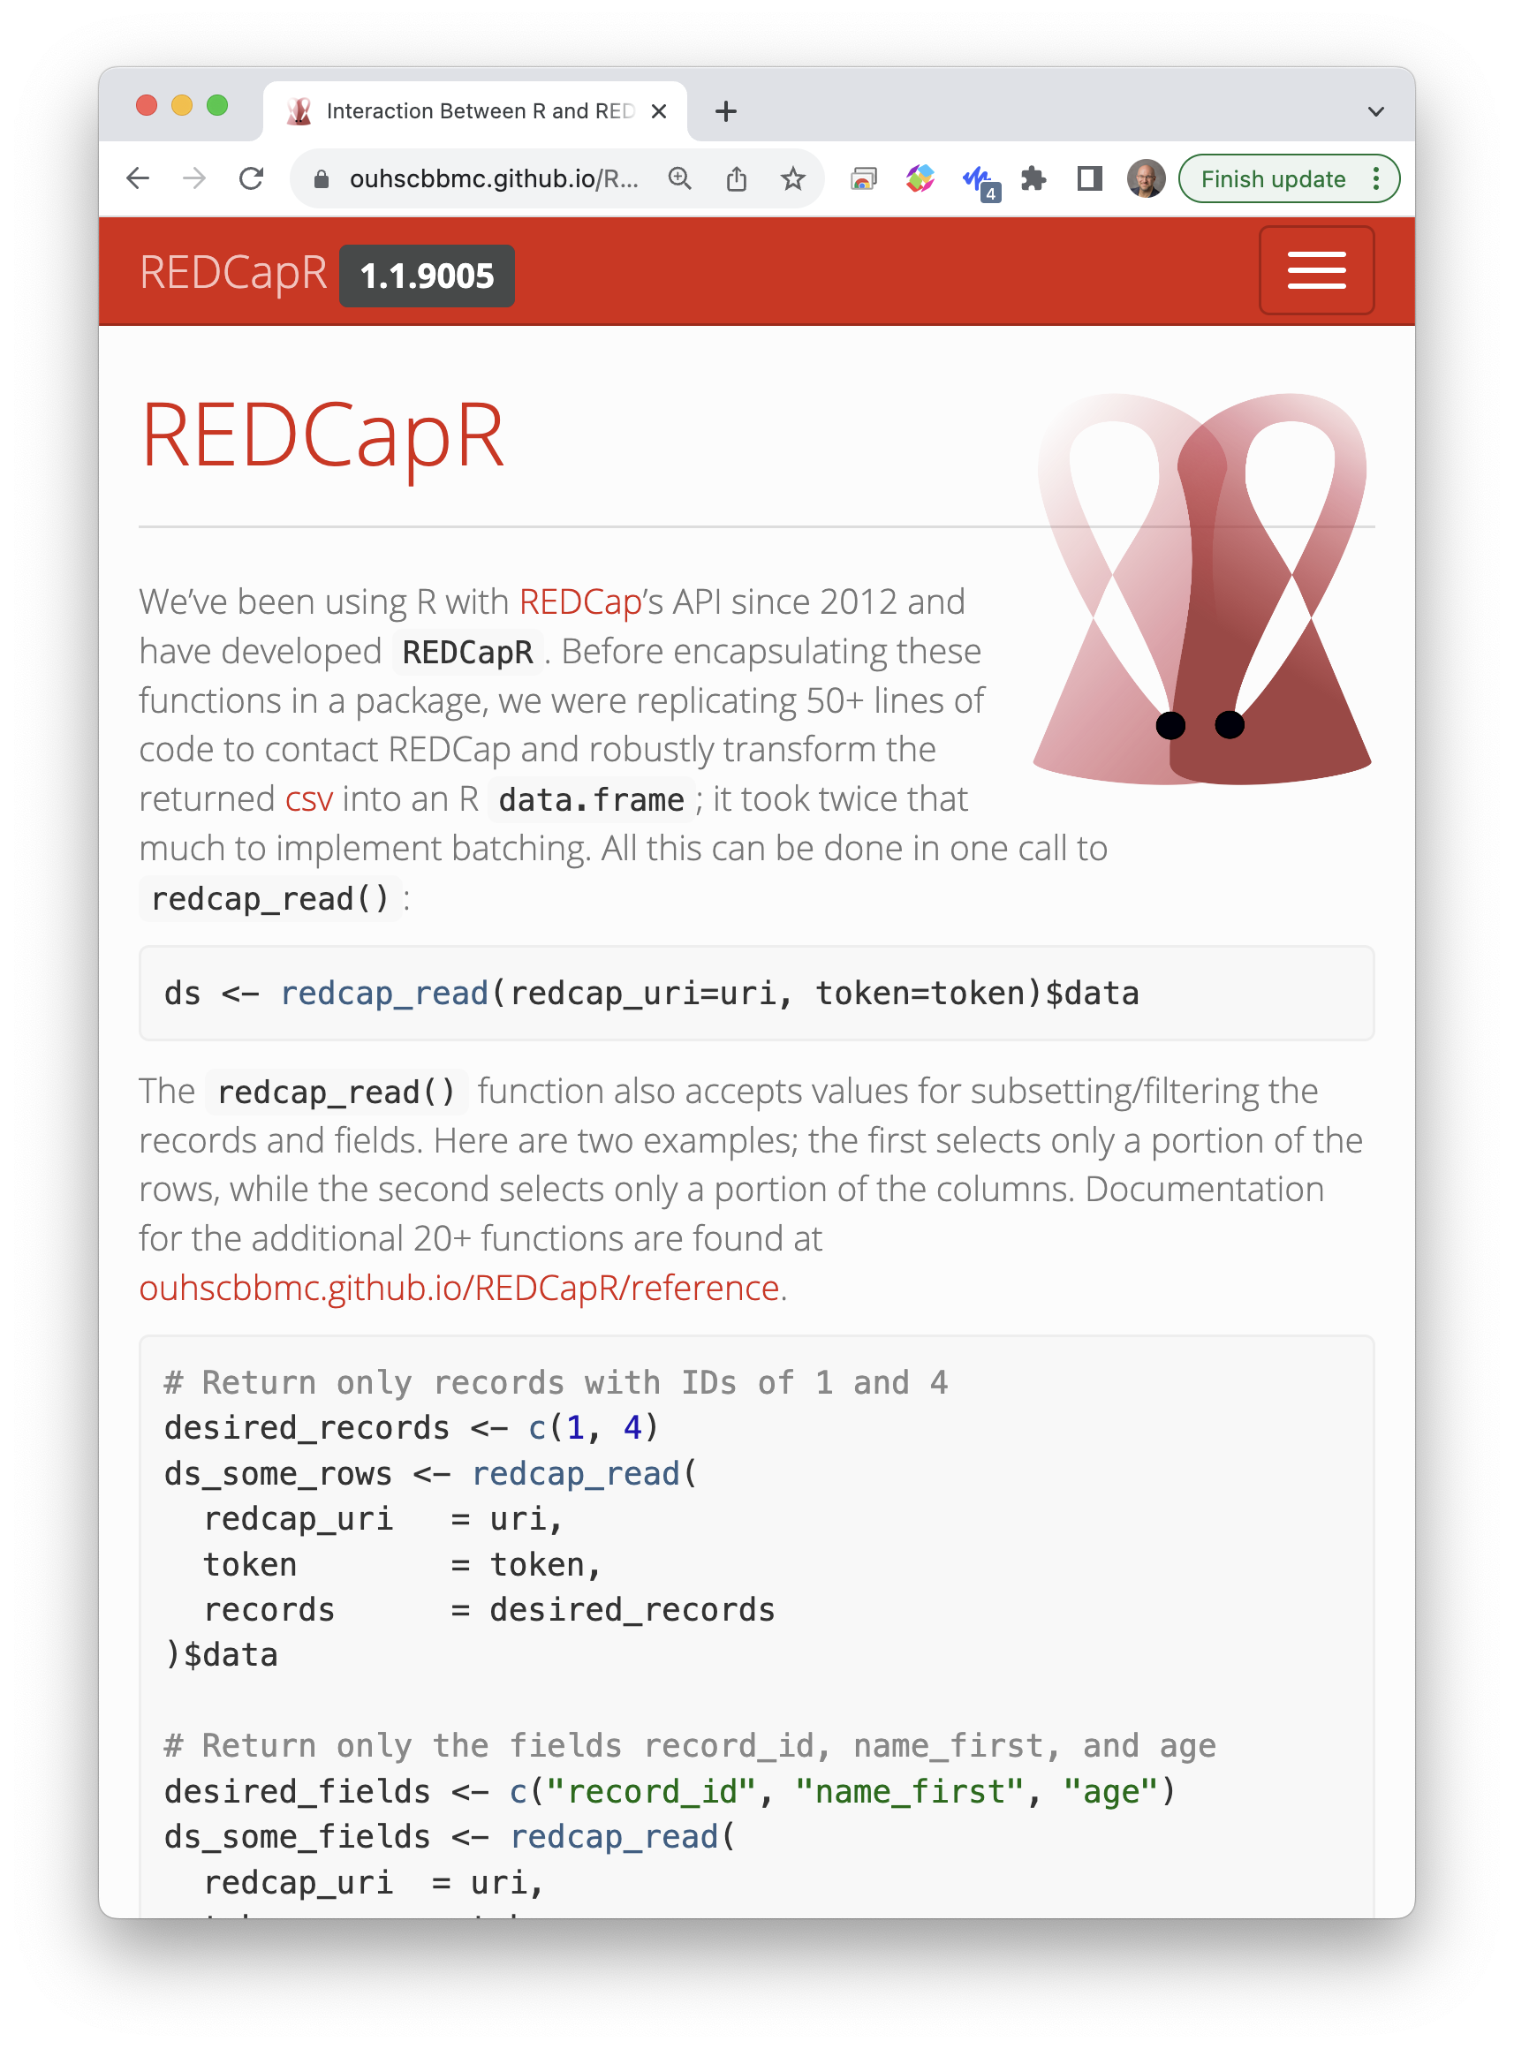
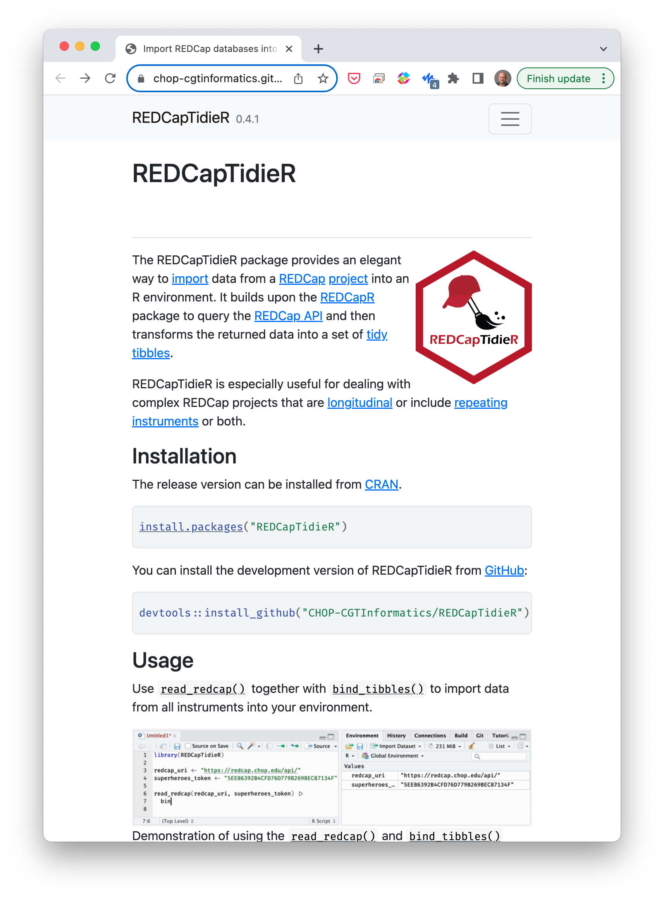

Slide 12




Notes:
tidyREDCap is a package that simplifies the tables for instruments and choose-all or choose-one question types. It is easy to make tables and it depends on REDCapR. It requires the first and last columns to make instruments.
redcapAPI is a package for making data accessible and analysis-ready as quickly as possible with huge documentation in a wiki but has no vignette or examples and it does not depend on REDCapR.
REDCapDM is a package that provides functions to read and manage REDCap data and identify missing or extreme values as well as transform the data provided by the API. It depends on REDCapR.
REDCapExporter is a package to build a data package from a database for redistribution. It does not depend on REDCapR.

